Slide 1

Hobby Web application

Slide 2
introduction
Profile
- Sanru Mathybalan
- QA Digital Consultant – Software Engineer
- Graduated at Cardiff University in Software Engineer
Assessment 2:
I was required to build a functional OOP-based web application that an end user can interact via HTML page and perform various tasks.

Slide 3

The Approach
Project Requirements
Spring Boot Application
ERD
Risk Assessment
UML
Project Management Tools - Jira

Slide 4
Consultancy Journey
Version Control System: Git
Source Code Management: GitHub
Kanban Board: Jira
Database Management System: MySql and H2 database
Testing Database: Postman
Back-End Programming Language: Java Spring boot
Front-End Programming Language: Vanilla JavaScript, HTML and CSS
API : Axios
Build Tool: Maven & VS code
Unit Testing : JUnit, Mockito, Selenium

Slide 5
Learned Technologies
Git and GitHub
JUnit Testing (integration Testing & selenium Testing)
Build Tool: Spring boot Maven & VSCode
Database: MySql and H2

Slide 6
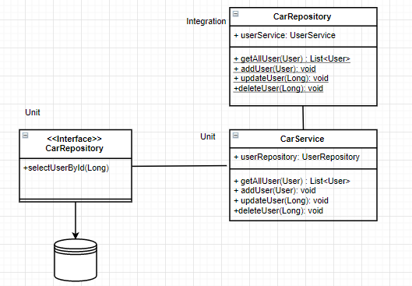
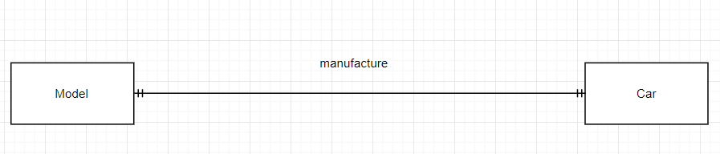
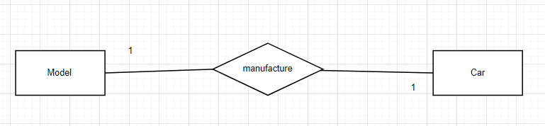
ERD & UML Diagram

Slide 7
Continuous Version Control
For this project I have used GIT for version control
It is world's popular version control system
Helped me manage my project files
How Git Helped me with this project?
-History (git Tracks changes)
- Collabration (merge changes)
- Feature branches (able to work on different feature and merge when needed)

Slide 8

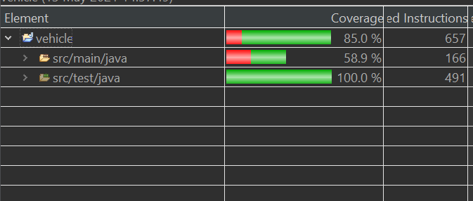
Testing
For this project I have used Junit testing and mockito for the Backend
Selenium Testing for the front-end
Required dependencies: ​
Spring-boot-starter-data-jpa​
Spring-boot-starter-test​
MySql-driver
Mockito
H2 (in-memory database)​
JUnit Testing

Slide 9

Demonstration

Slide 10
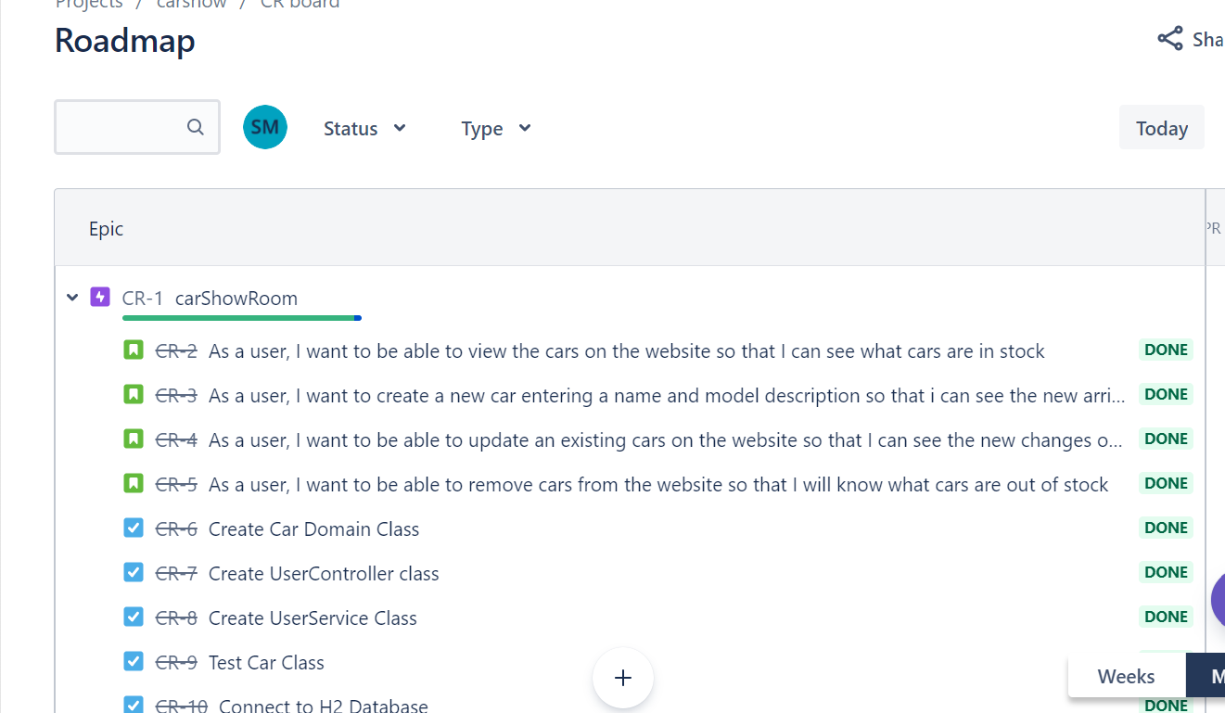
User Stories
-- for this project
: Used Jira to design the User stories
-- easy to manage issues
-- Able to track development stages
- Story points
- Sprint

Slide 11

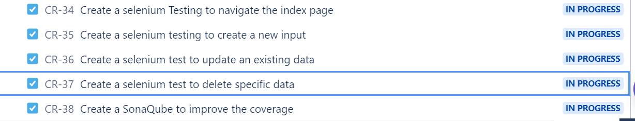
Sprint Review
38/42 issues completed
2 issues were moved to a new sprint:
-Selenium (connect to a random port)
-find the correct chromedriver.
2 issues that were not completed :
-Sonaqube
-Testing for bugs

Slide 12
Risk Assessment
Description | Evalution | Response | Control Measures
Technical Hardware Issues | Workstation breakdowns would result in failure to compelete website within timeframe. | Utilize alternative workstation such as personal laptop or pc whilst informing QA to issue a replacement. | Ensuring project follows iterative procedures (SCRUM). Project is therefore broken down and each progress is regularly committed to remote. Should any hardware issues occur; can simply pull source code to personal laptop and continue working.
Technical Software Issue | If the tools necessary to implement, test and deploy code crashes, this would result in incompletion of project within deadline. | Attempt to reinstall software and trouble-shoot online for further support. | Ensure software is regularly updated as it may prevent from bugs.
Internet Connectivity | Internet goes down preventing access to online resources. | Contact internet Service Provider to resolve the problem. | Until internet is resolved locally, use mobile data where required.
Failing to fully understand the scope | Unsure reviewing the project scope and hence failing to meet MVP. | Review scope to ensure application is what's requested | Constantly refer-back to MVP checklist on scope document.

Slide 13
Risk Retrospective
What went well
What could be improved

Slide 14

Conclusion
- Add more functionality
- Add more fields
- Use validations
- More research and use different rescources
- Practing more on testing and coding to do better in the future.

